Slide 1

BookMyCourt
MARWADI UNIVERSITY
FACULTY OF DIPLOMA STUDIES
COMPUTER ENGINEERING DEPARTMENT
Prepared by:
Ridham Godhani – 92300938061
Rishit Dabhi – 92300938078
Divy Dadhania – 92300938079
Dev Thakar – 92300938081
Trushal Sarvaiya – 92300938101
SEMESTER : 6
Project Review - 4
Guided by:
PROF. KHUSHBOO MARWADI

Slide 2
CONTENT
Acknowledgement
Aim / Objectives
Specific Requirements(Software/Hardware)
System Design(Diagrams)
Result
Conclusion

Slide 3
Acknowledgment
We are immensely grateful to the individuals and mentors who played a pivotal role in shaping BookMyCourt, our vision for revolutionizing sports facility bookings. Their unwavering support and expertise transformed our abstract ideas into a structured Software Requirements Specification (SRS) report.
A special note of thanks to Prof. Smit Thacker (Head of Department) and Prof. Khushboo Marwadi (Internal Guide) for their relentless encouragement, critical insights, and patience in guiding us through every phase of this project. Their ability to challenge our assumptions while nurturing creativity was invaluable.

Slide 4
OBJECTIVES
To make booking sports facilities easy and fully online.
To show real-time availability of courts and time slots.
To help venue owners manage bookings and schedules digitally.
To provide secure and smooth online payment options.
To give users a fast, clean, and user-friendly booking experience.
To reduce manual work, errors, and communication gaps.
To create a scalable, reliable, and secure sports booking system.

Slide 5
Specific Requirements
Hardware Interfaces
The BookMyCourt platform is web-based and supports interaction through standard hardware interfaces.
Client-Side Devices Supported: Desktops, laptops, tablets, and smartphones. Requirements: Devices must support modern browsers with JavaScript and React.js. Interaction: Users interact via standard input/output (keyboard, mouse, touchscreen).
Server-Side Infrastructure Hosting: Deployed on cloud platforms like AWS or Heroku. Database: Uses MongoDB Atlas with secure server communication. Interaction: Backend (Node.js/Express.js) communicates with the database and APIs.
Third-Party Device Access (Future Scope) : Future integration may include IoT devices such as smart gates or lighting via APIs or SDKs.

Slide 6
Software Interfaces
Server: Backend runs on Linux (Ubuntu) using Node.js + Express, hosted on cloud platforms (AWS/Heroku).
Client: Accessible via modern browsers on Windows, macOS, Linux, Android, and iOS.
Uses MongoDB Atlas with Mongoose for schema management and operations.
Stores data like users, facilities, bookings, reviews, and payments.
Data is exchanged securely via HTTPS in JSON format.
bcrypt for password hashing and JWT for authentication.

Slide 7
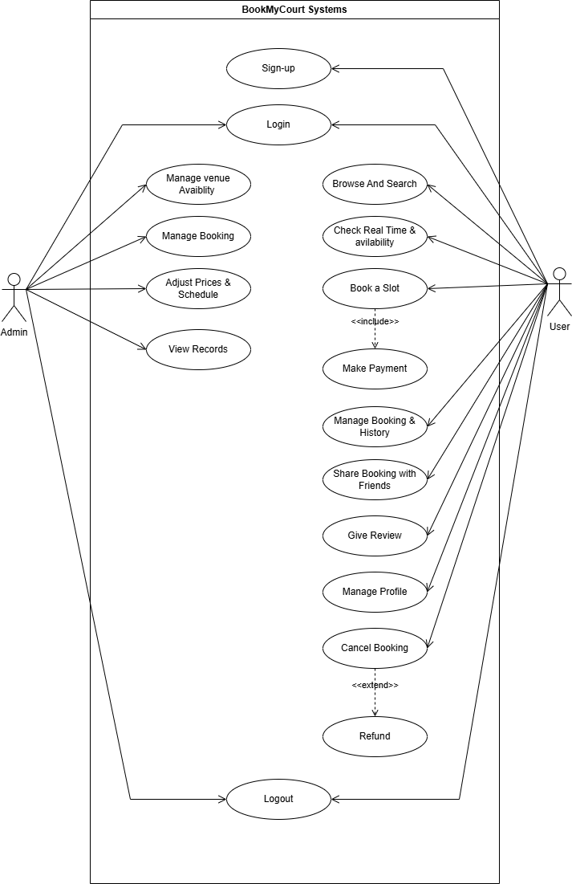
SYSTEM DESIGN(DIAGRAMS)
Figure 1.1 Use Case Diagram

Slide 8
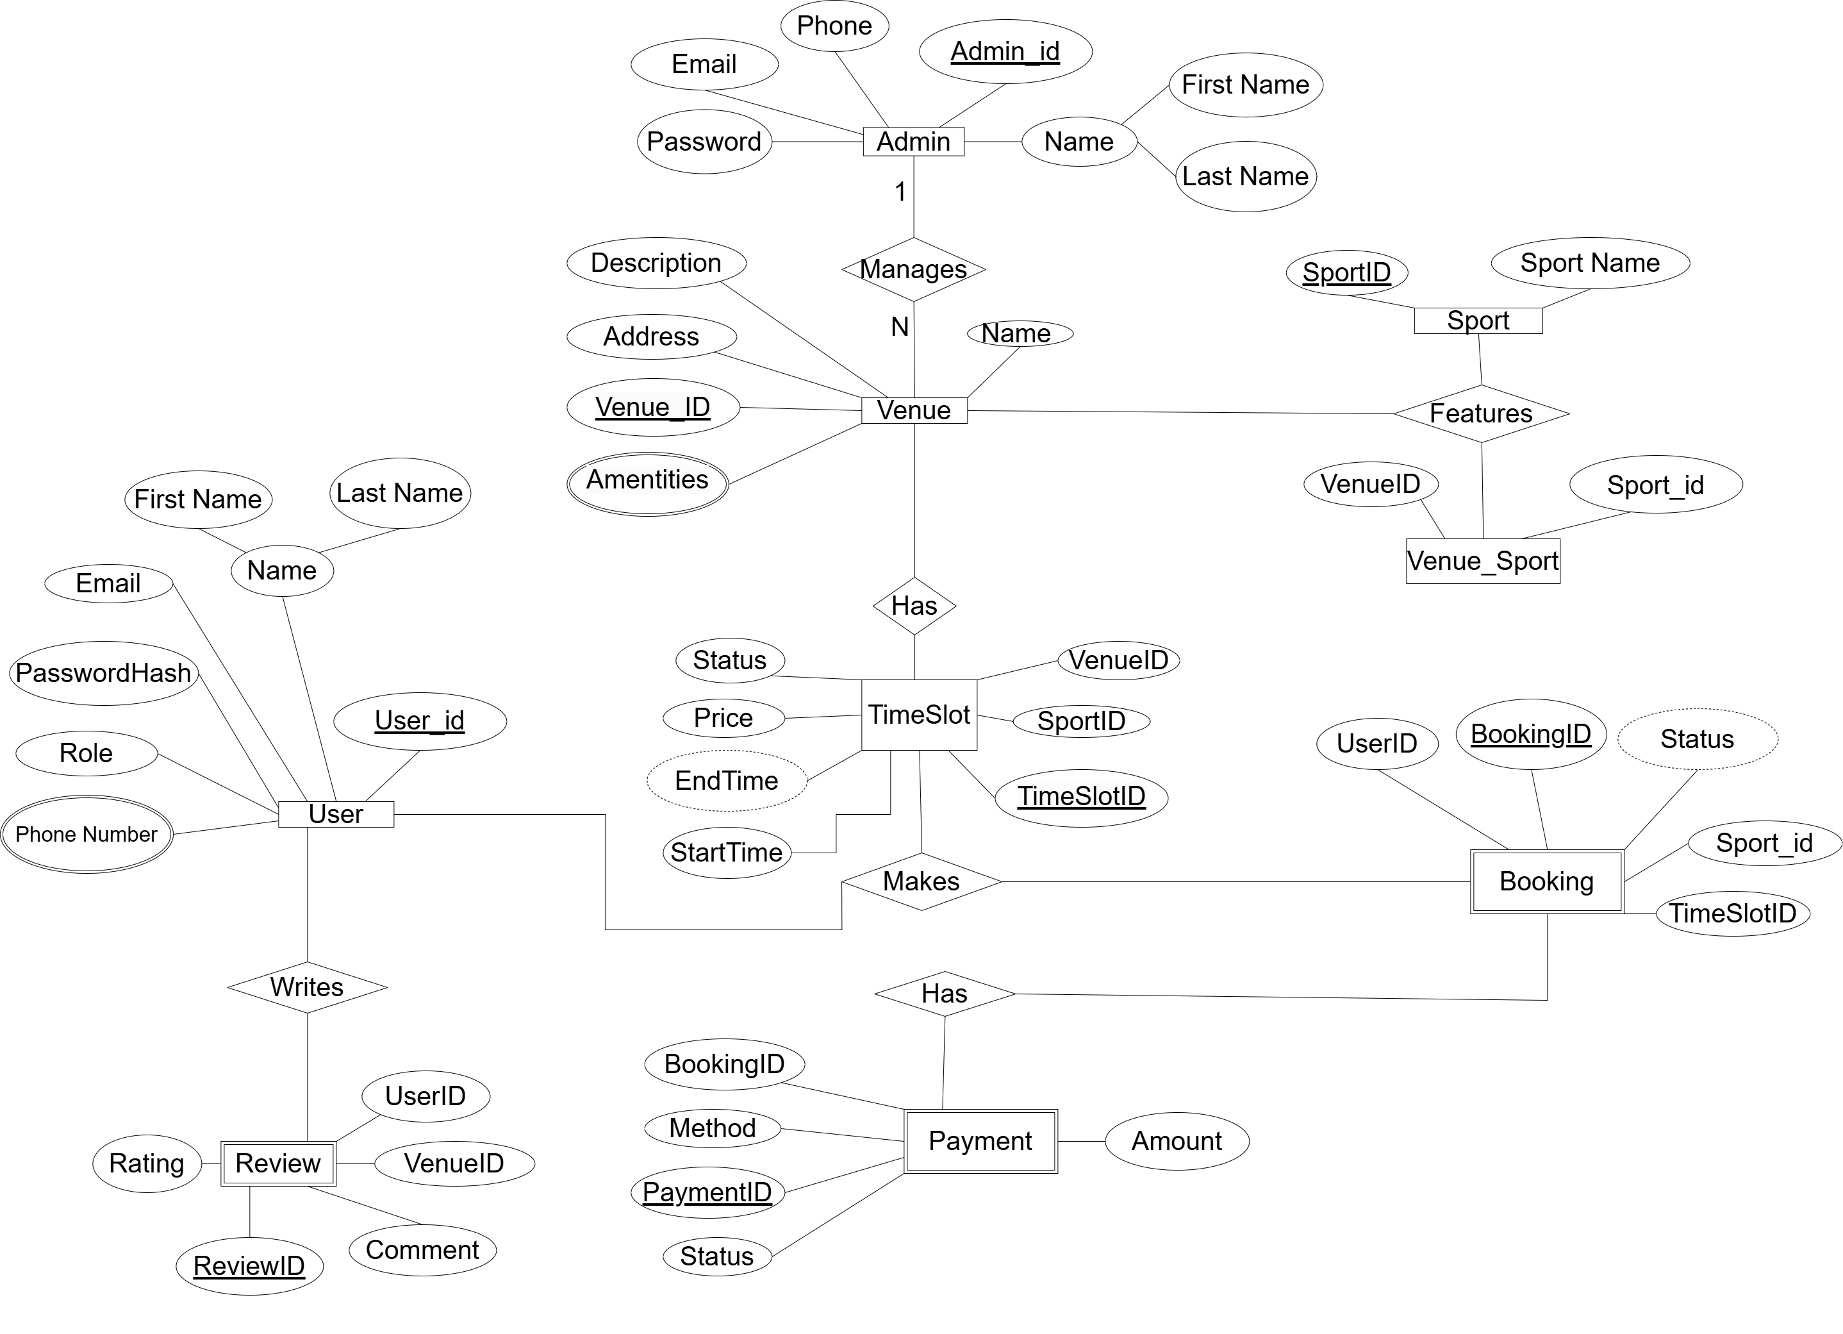
Figure 1.2 E.R. Diagram

Slide 9
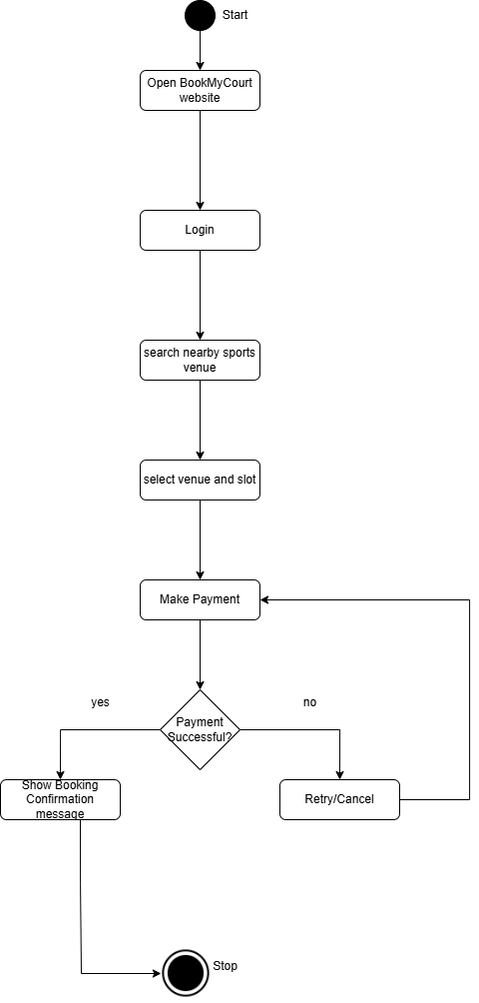
Figure 1.3.1 user Activity Diagram

Slide 10
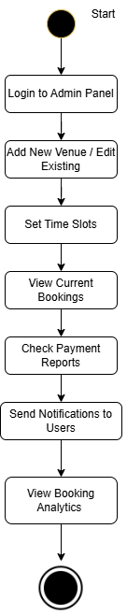
Figure 1.3.2 Admin Activity Diagram

Slide 11
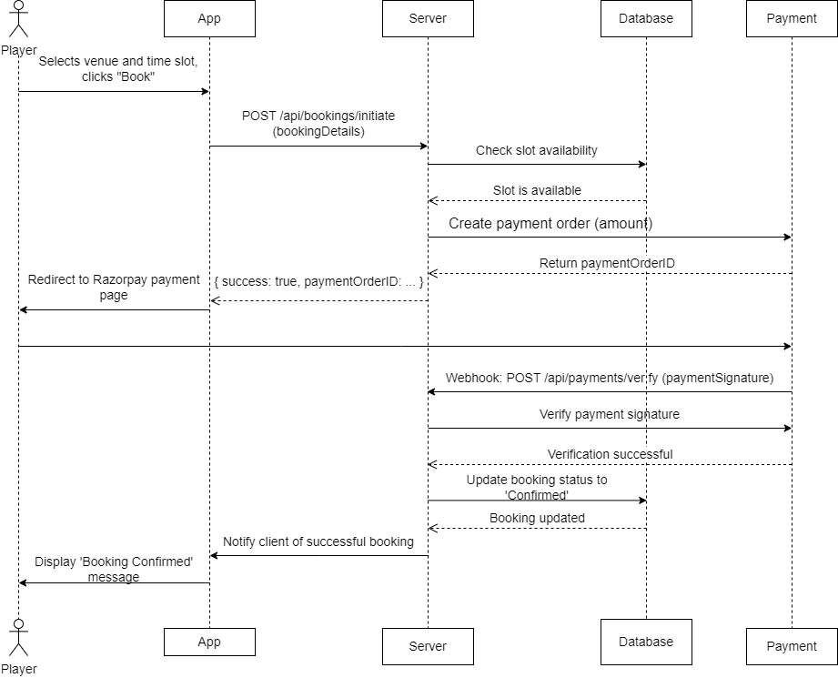
Figure 1.4 Sequence Diagram

Slide 12
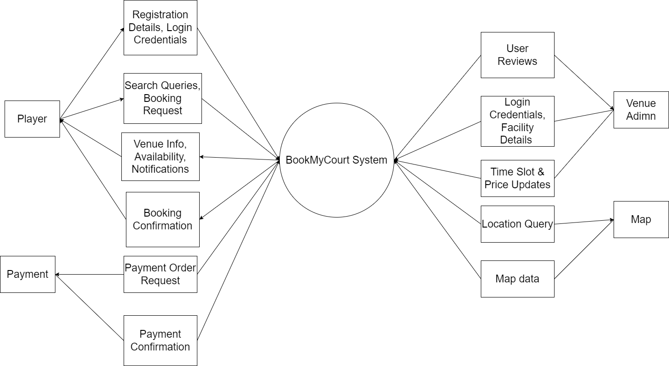
Figure 1.5 DFD Diagram (Level 0)

Slide 13
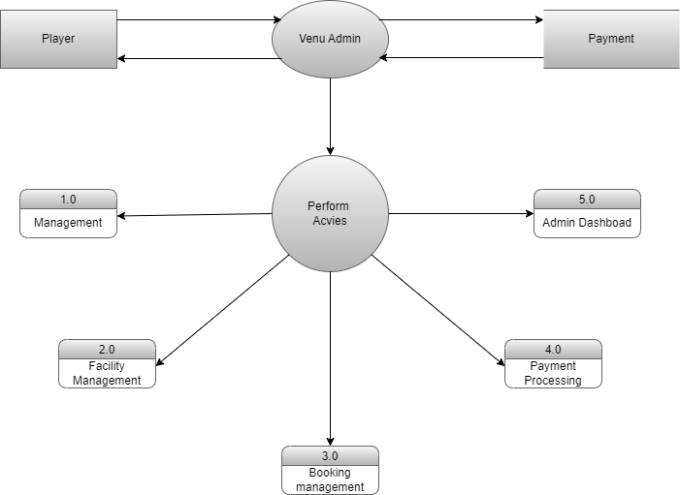
Figure 1.6 DFD Diagram (Level 1)

Slide 14
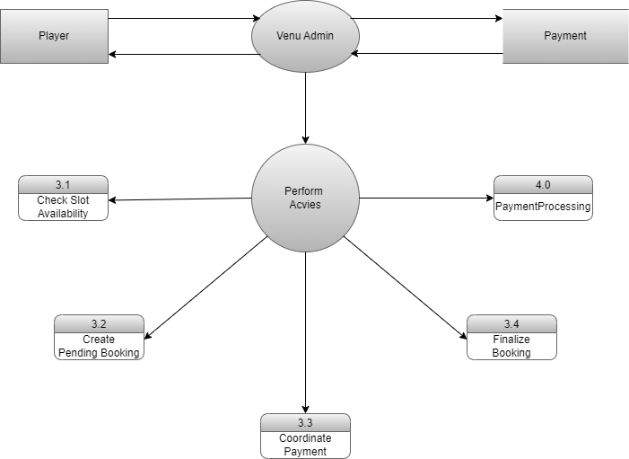
Figure 1.7 DFD Diagram (Level 2)

Slide 15
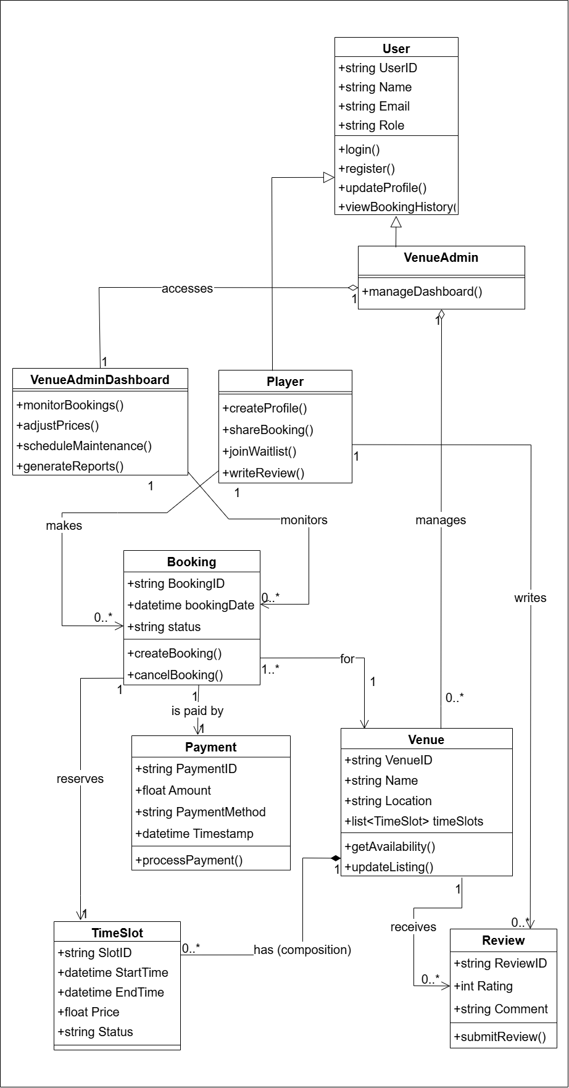
Figure 1.8 Class Diagram

Slide 16
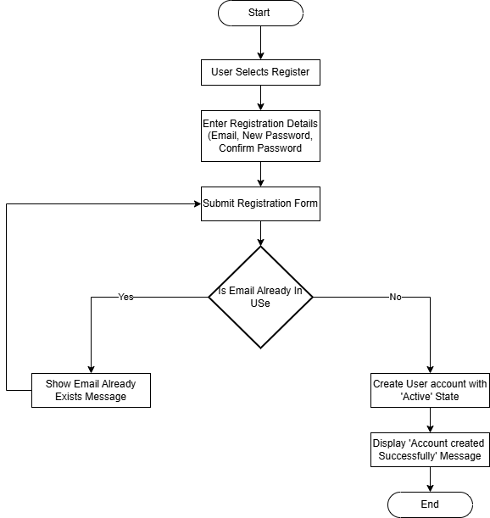
Figure 1.9 Flowchart

Slide 17
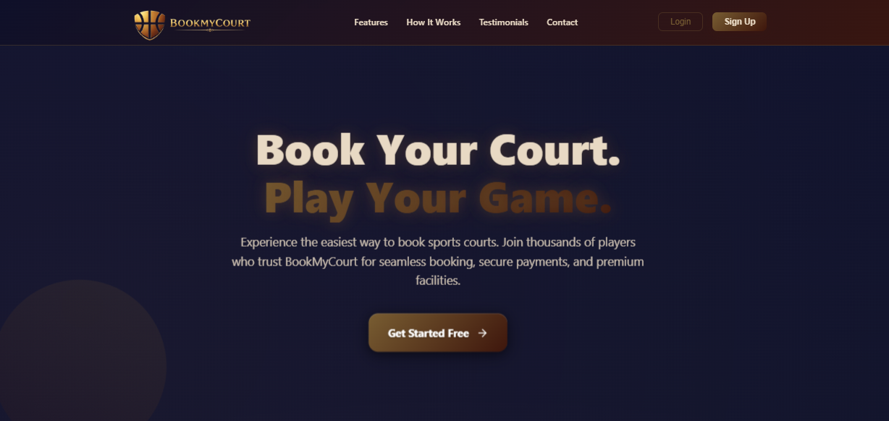
Result
HOMEPAGE

Slide 18
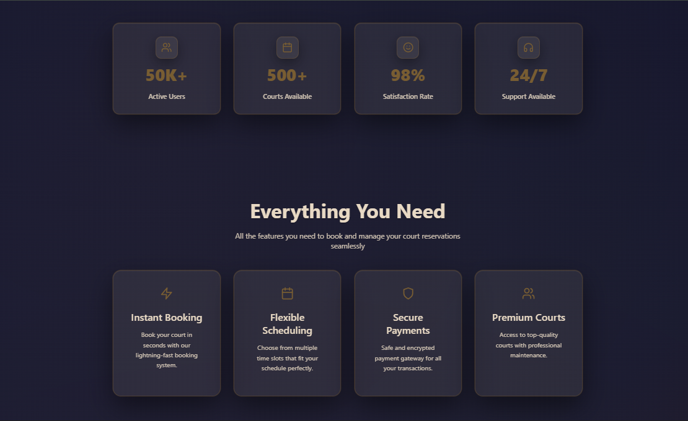

Slide 19
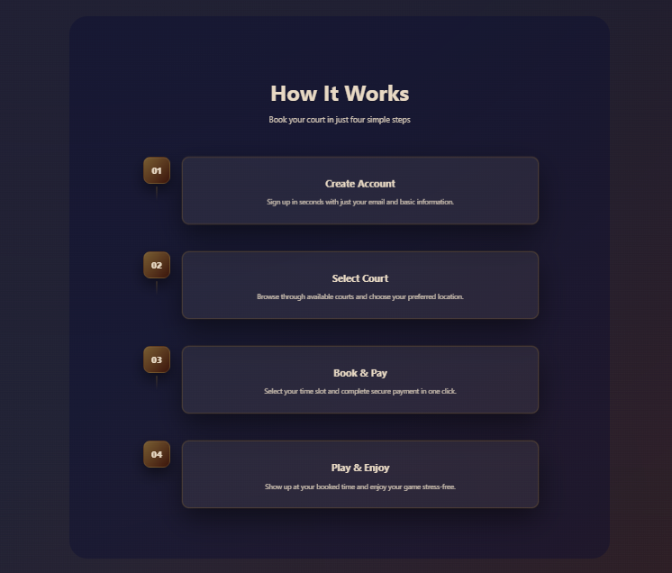

Slide 20
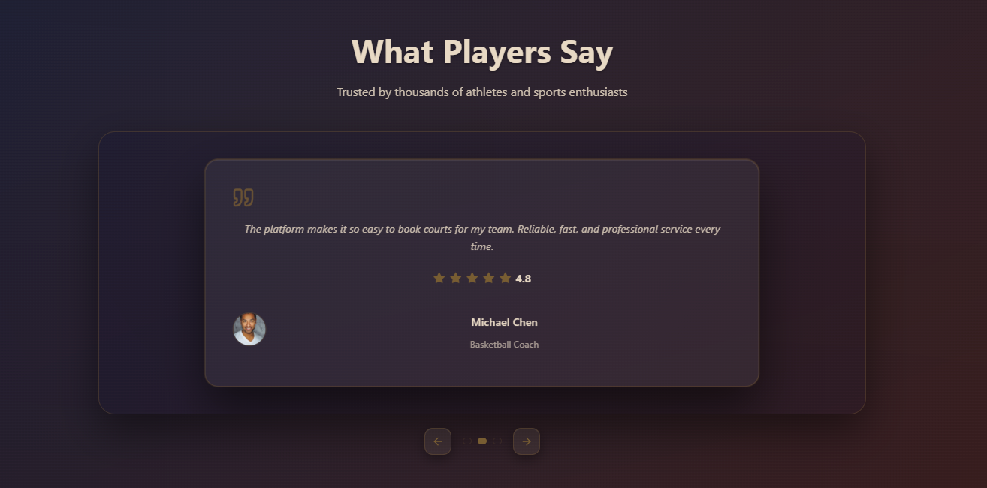

Slide 21
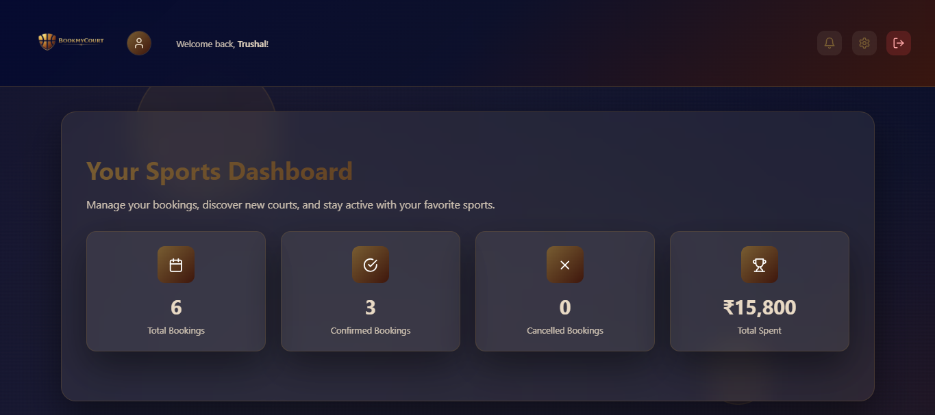
USER DASHBOARD

Slide 22
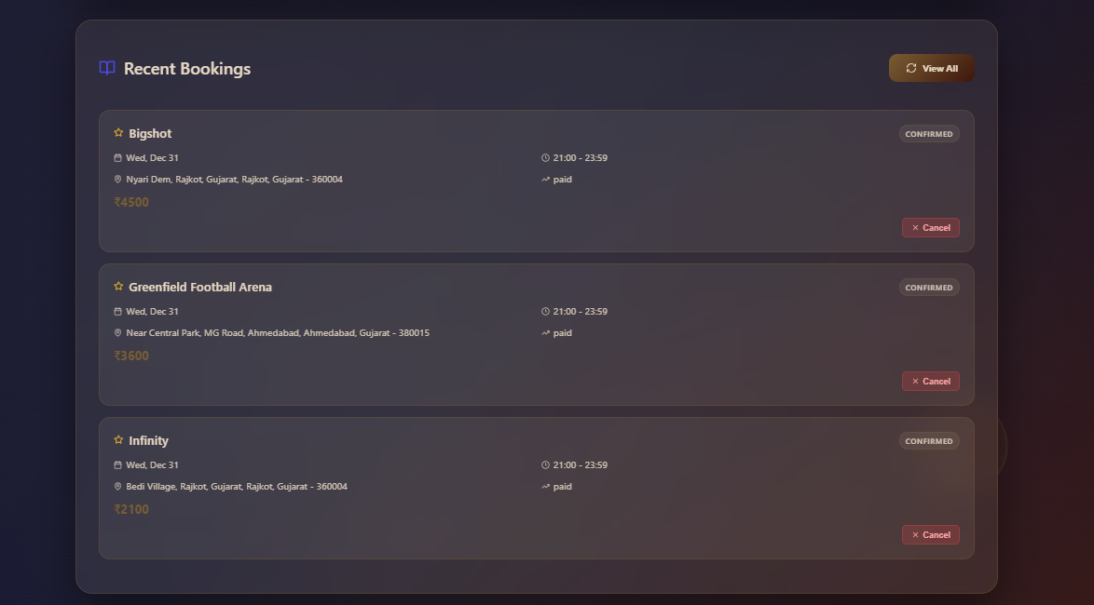

Slide 23
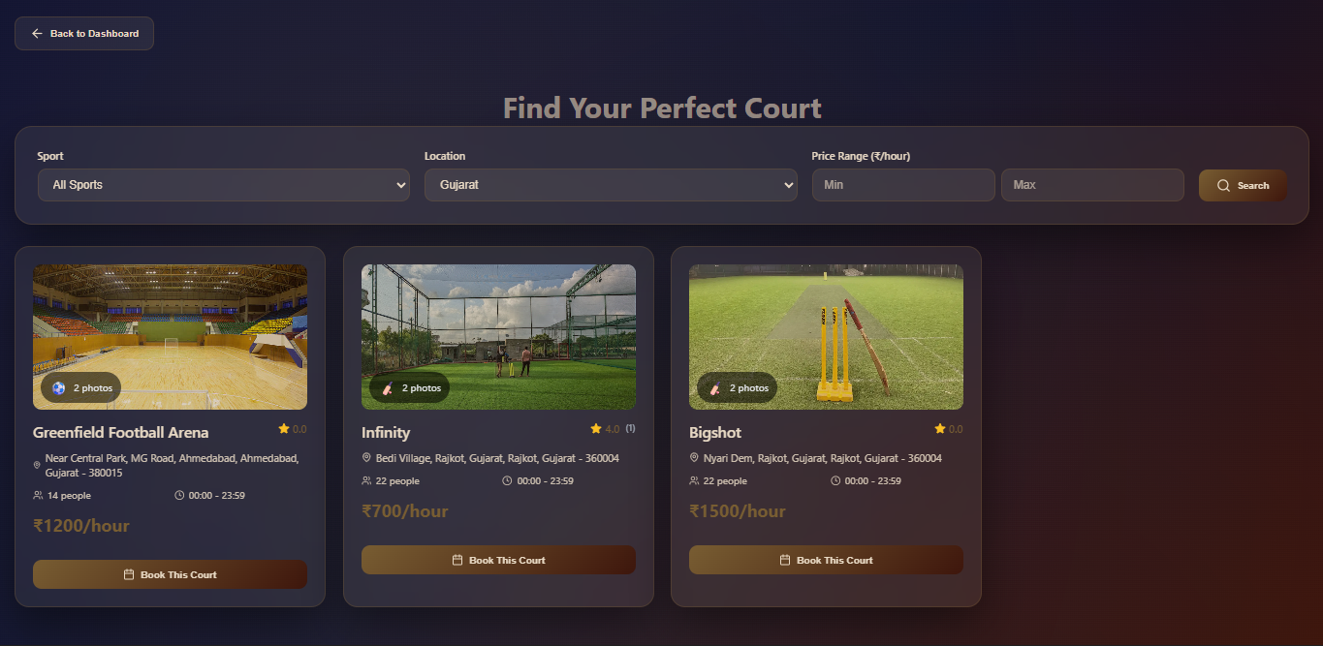

Slide 24
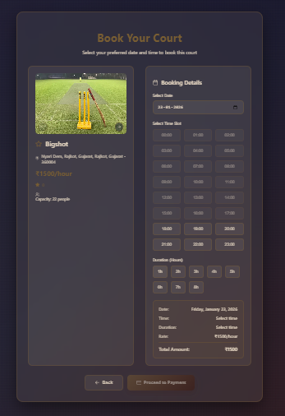

Slide 25
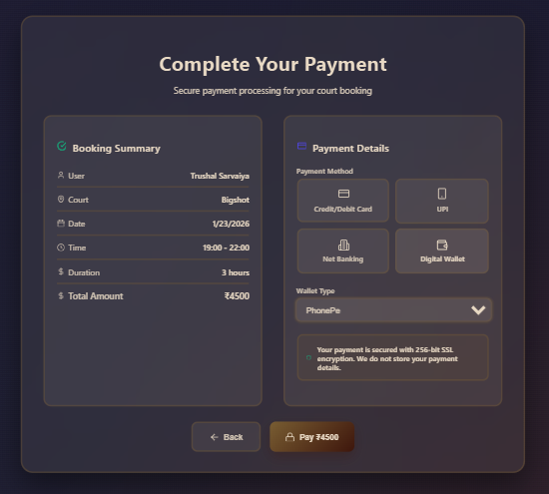

Slide 26
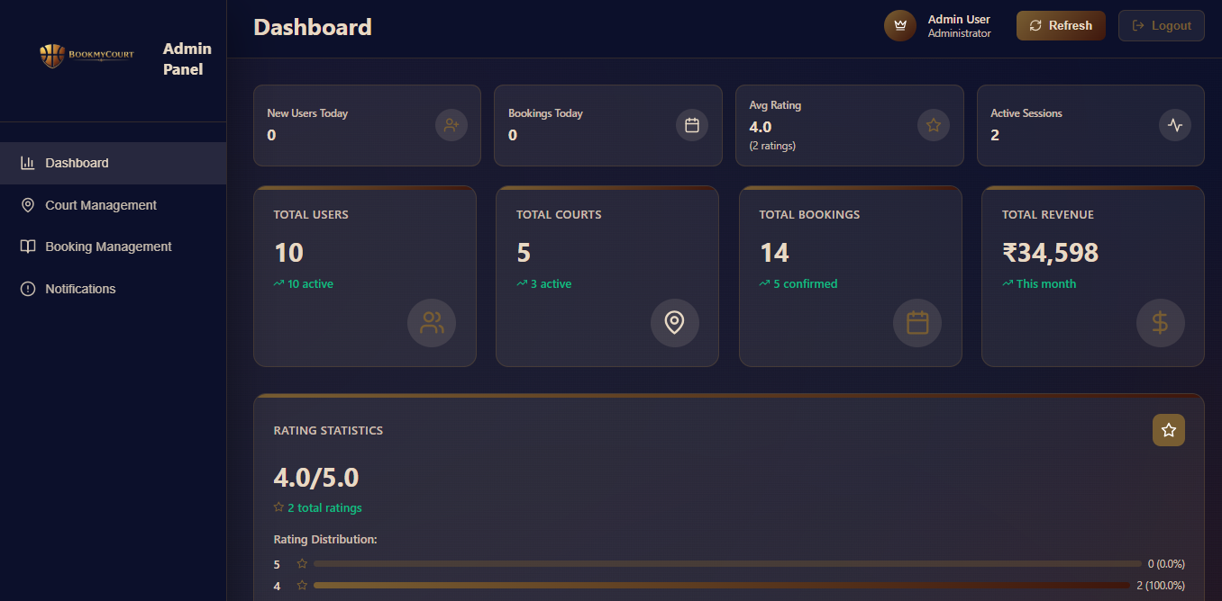
ADMIN DASHBOARD

Slide 27
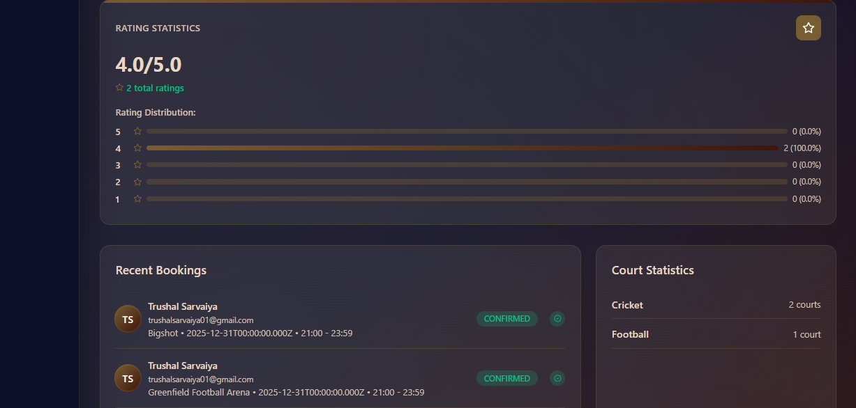

Slide 28
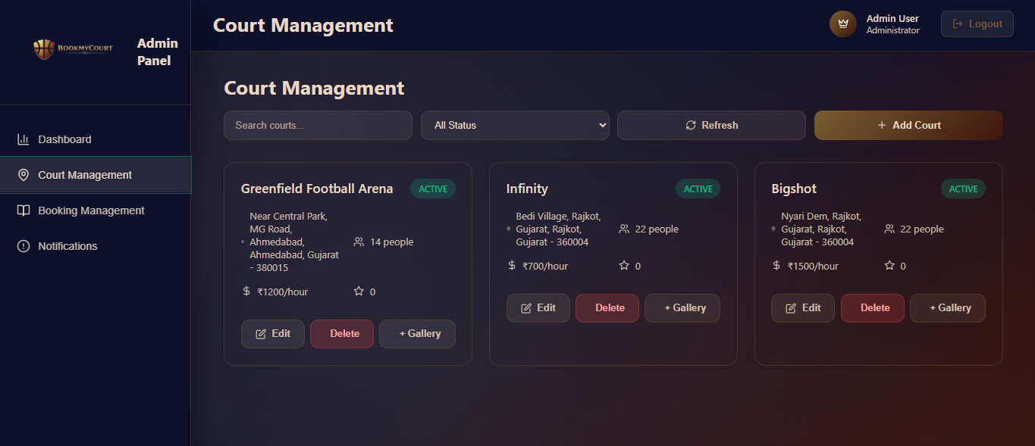

Slide 29
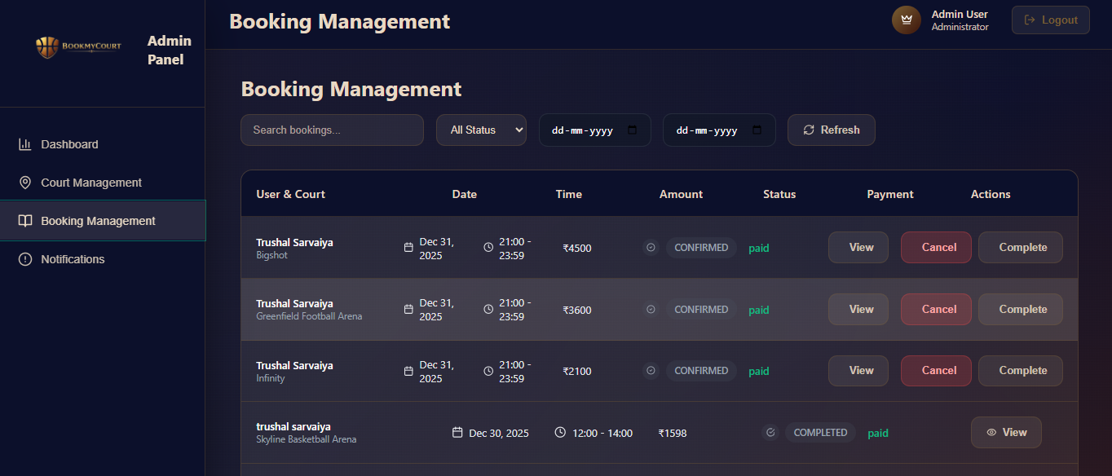

Slide 30
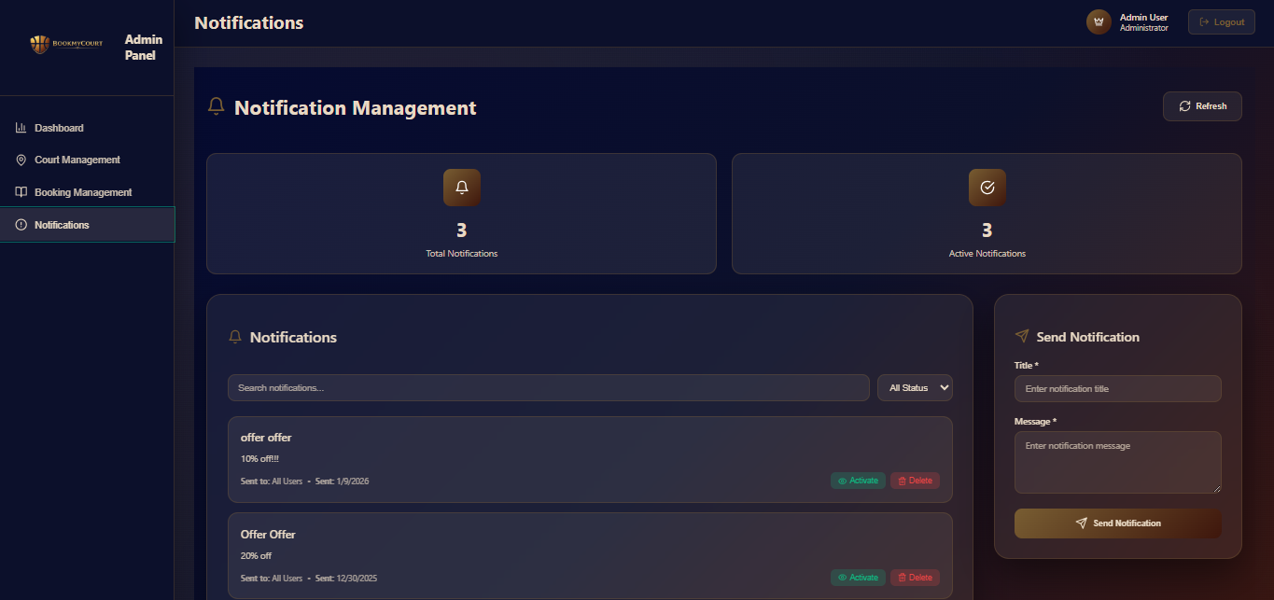

Slide 31
CONCLUSION
BookMyCourt makes booking sports grounds very easy for all people. Instead of calling or going to the place, users can see all courts online, check free time, and book quickly. Owners can also manage their grounds, update slots, and handle bookings in one simple dashboard. The system works fast, is safe to use, and can grow in the future. Overall, BookMyCourt helps players book courts without trouble and helps venue owners manage everything smoothly and easily.

